Slide 1

Parallel Programming in C with MPI and OpenMP
Michael J. Quinn

Slide 2
Chapter 3
Parallel Algorithm Design

Slide 3
Outline
Task/Channel Model
Algorithm Design Methodology
Case Studies
  Boundary value problem
  Finding the maximum
  The n-body problem
  Adding data input

Slide 4
Task/Channel Model
Parallel computation
  a set of tasks interact by sending messages through channels
Task
  Program + Local memory + Collection of I/O ports
Channel
  a message queue (output port ➔ input port)
  Receiving is a synchronous operation (wait➔block)
  Sending is an asynchronous operation

Slide 5
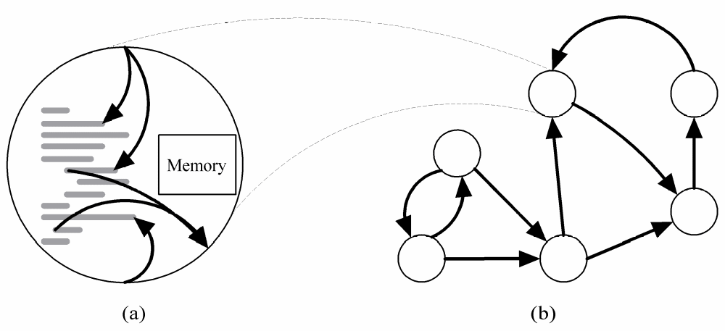
Task/Channel Model
Task
= Program
+ Local Memory
+ I/O Ports
Task
Channel

Slide 6
Foster’s Design Methodology
Ian Foster has proposed a 4-steps process for designing parallel algorithms
Partitioning
Communication
Agglomeration
Mapping

Slide 7
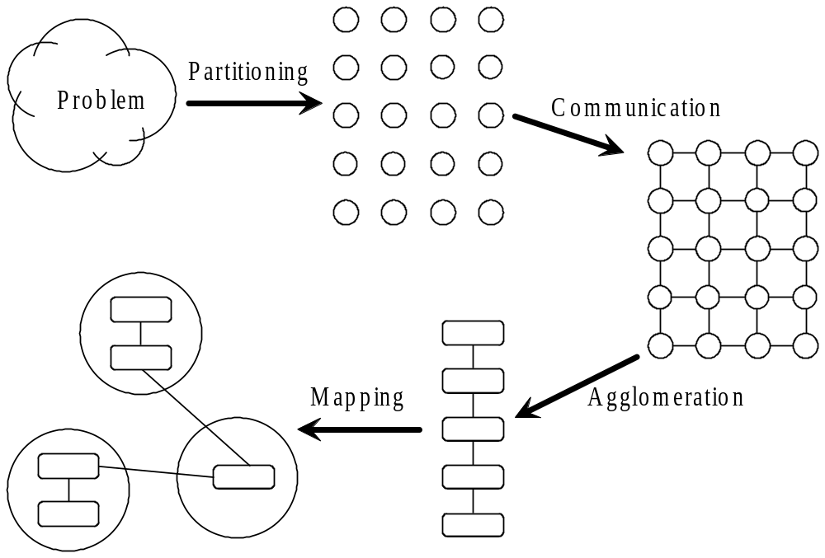
Foster’s Methodology
(1)
(2)
(4)
(3)

Slide 8
Partitioning
Dividing computation and data into pieces.
  Data-centric approach or computation-centric approach
Domain decomposition
  Divide data into pieces
  Determine how to associate computations with the data
Functional decomposition
  Divide computation into pieces (e.q. pipelining)
  Determine how to associate data with the computations

Slide 9
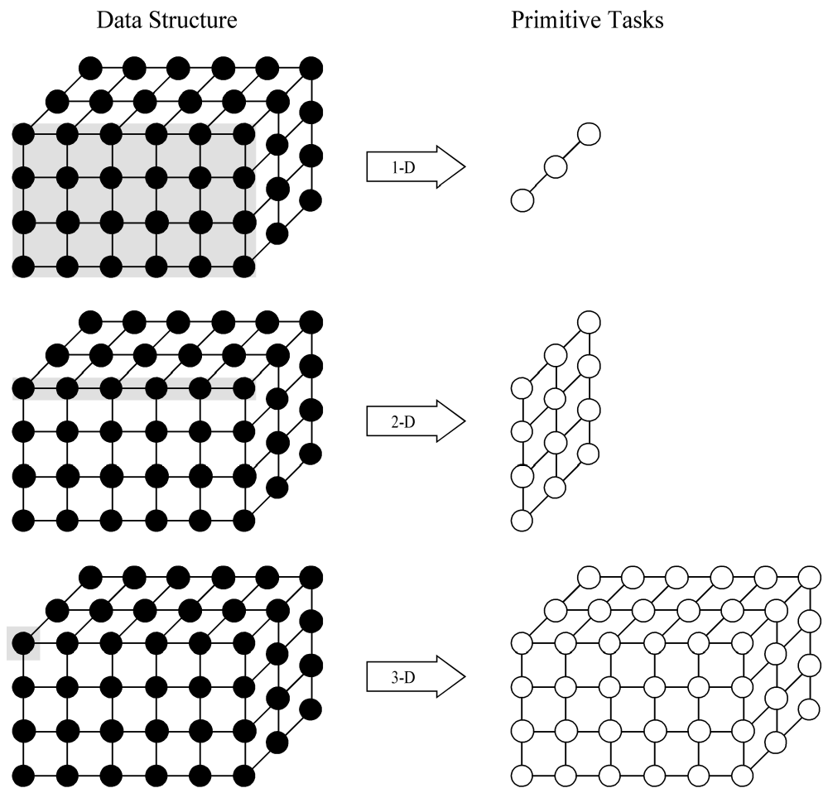
Example Domain Decompositions
Data Structure Primitive Tasks
Three domain decompositions of a 3D matrix

Slide 10
Example Functional Decomposition
Track Position of
Instruments
Acquire Patient
Images
Register
Images
Determine Image
Locations
Display Image
Functional decomposition of a system supporting
interactive image-guided surgery

Slide 11
Partitioning Checklist
More tasks: At least 10× more primitive tasks than processors in target parallel computer.
Less redundancy: Minimize redundant computations and redundant data structure storage.
Same size: Primitive tasks are roughly the same size.
Scalability: The number of tasks is an increasing function of the problem size.

Slide 12
Communication
Determine values passed among tasks
Local communication
  Task needs values from a small number of other tasks
  Create channels illustrating data flow
Global communication
  Significant number of tasks contribute data to perform a computation
  Don’t create channels for them early in design

Slide 13
Communication Checklist
Equal traffic: Communication operations balanced among tasks
Less traffic: Each task communicates with only small group of neighbors
Talking: Tasks can perform communications concurrently
Working: Tasks can perform computations concurrently

Slide 14
Agglomeration
Grouping tasks into larger tasks
  Improve performance (a.)
  Simplify programming (b.)
Goals
  Lower communication overhead (a.)
  Maintain scalability of the parallel design (a.)
  Reduce software engineering cost (b.)
In MPI programming, goal often to create one agglomerated task per processor

Slide 15
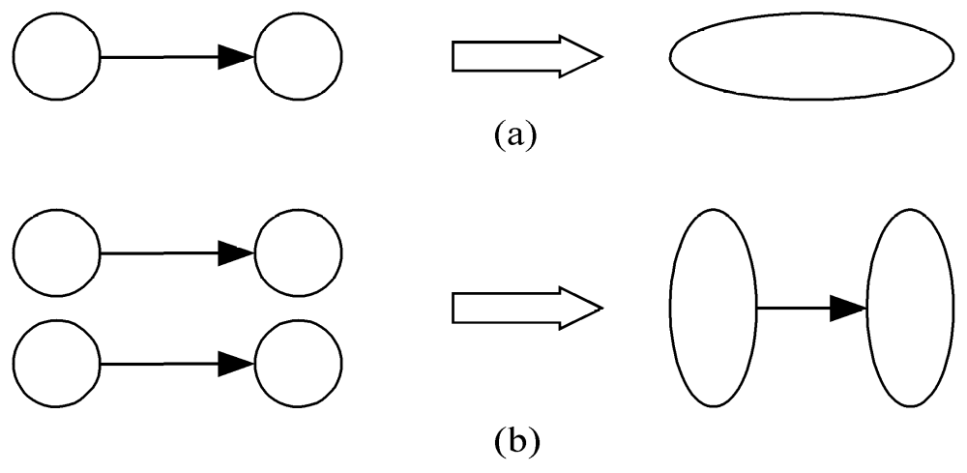
Agglomeration Can Improve Performance
Increasing the locality: Eliminate communication between primitive tasks agglomerated into consolidated task
Reducing channels: Combine groups of sending and receiving tasks
Increasing the locality
Reducing the transmissions

Slide 16
Agglomeration Checklist
Tuning partitioning and communication.
Locality of parallel algorithm has increased
Replicated computations take less time than communications they replace
Data replication doesn’t affect scalability
Agglomerated tasks have similar computational and communications costs
Number of tasks increases with problem size
Number of tasks suitable for likely target systems
Trade-off between agglomeration and code modifications costs is reasonable

Slide 17
Mapping
Process of assigning tasks to processors
Centralized multiprocessor
  mapping done by operating system
Distributed memory system
  mapping done by user (our target)
Conflicting goals of mapping
  Maximize processor utilization
  Minimize inter-processor communication

Slide 18
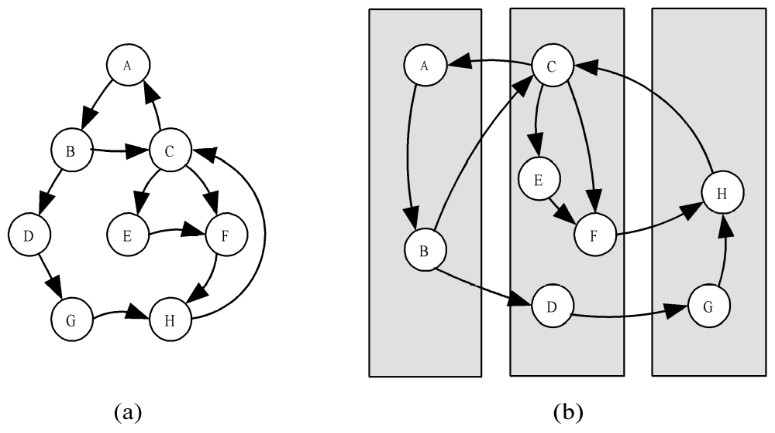
Mapping Example
PU
PU
PU
Task/channel graph
Mapping of tasks to three processors

Slide 19
Optimal Mapping
Finding optimal mapping is NP-hard
  There are no known polynomial-time algorithms to map tasks to processors to minimize the execution time.
  NP-hard
    NP-hard, NIST, http://www.nist.gov/dads/HTML/nphard.html
    NP-hard, Wikipedia, http://en.wikipedia.org/wiki/NP-hard
Must rely on heuristics

Slide 20
Decision Tree of Mapping Strategy (1)
Static number of tasks
  Structured communication
    Constant computation time per task
      Agglomerate tasks to minimize communication
      Create one task per processor
    Variable computation time per task
      Cyclically map tasks to processors
  Unstructured communication
      Use a static load balancing algorithm
Dynamic number of tasks

Slide 21
Decision Tree of Mapping Strategy (2)
Static number of tasks
Dynamic number of tasks
  Frequent communications between tasks
    Use a dynamic load balancing algorithm
  Many short-lived tasks
    Use a run-time task-scheduling algorithm

Slide 22
Mapping Checklist
1 vs. M: Considered designs based on one task per processor and multiple tasks per processor
S vs. D: Evaluated static and dynamic task allocation
If dynamic task allocation chosen, task allocator is not a bottleneck to performance
If static task allocation chosen, ratio of tasks to processors is at least 10:1

Slide 23
Case Studies
Boundary value problem
Finding the maximum
The n-body problem
Adding data input

Slide 24
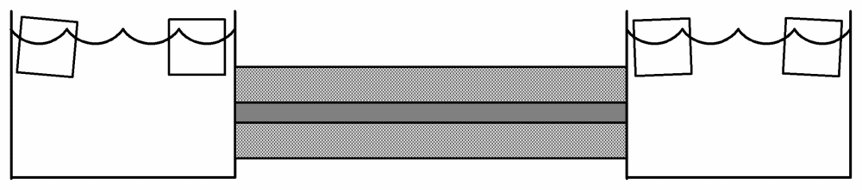
Boundary Value Problem
Case 1. Boundary Value Problem
Ice water
Rod
Insulation
A thin rod is suspended between two ice baths.
Then ends of the rod are in contact with the icewater.
The rod is surrounded by a thick blanket of insulation.
We can use a partial differential equation to model the
temperature at any point on the rod as a function of time

Slide 25
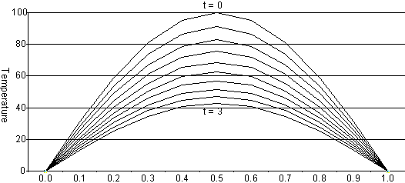
Rod Cools as Time Progresses
Case 1. Boundary Value Problem
The finite difference method finds the temperature
at a fixed number of points in the rod at certain time intervals.
Decreasing the size of the steps in space and time can lead to
more accurate solutions.

Slide 26
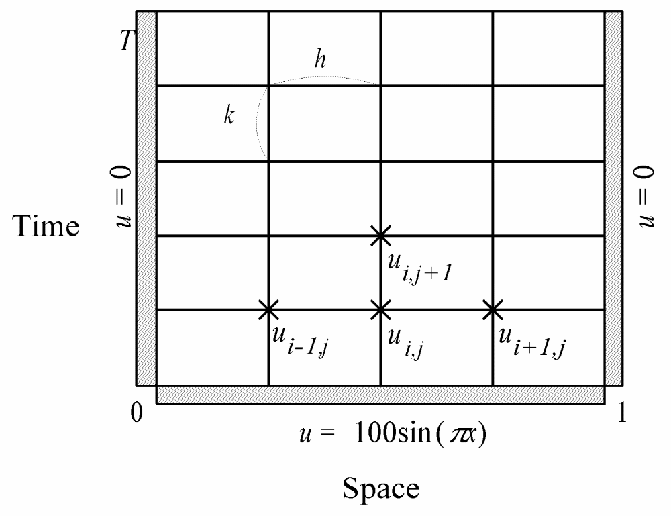
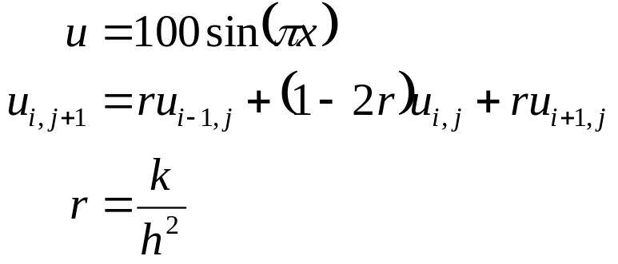
Finite Difference Approximation
Case 1. Boundary Value Problem
Data structure used in a finite difference approximation to the rod-cooling problem.
Every point u_{i,j} represents a matrix element containing the temperature
at position i on the rod at time j. At each end of the rod the temperature is always 0.
At time 0 the temperature at point x is 100sin(πx).

Slide 27
1. Partitioning
Case 1. Boundary Value Problem
One data item per grid point – easy
Associate one primitive task with each grid point
Two-dimensional domain decomposition

Slide 28
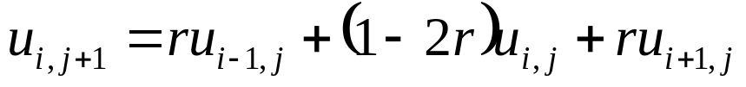
2. Communication
Case 1. Boundary Value Problem
Identify communication pattern between primitive task
Each interior primitive task has three incoming and three outgoing channels
u_{i,j}
u_{i-1,j+1}
u_{i,j+1}
u_{i+1,j+1}
u_{i-1,j-1}
u_{i,j-1}
u_{i+1,j-1}
u_{i,j}

Slide 29
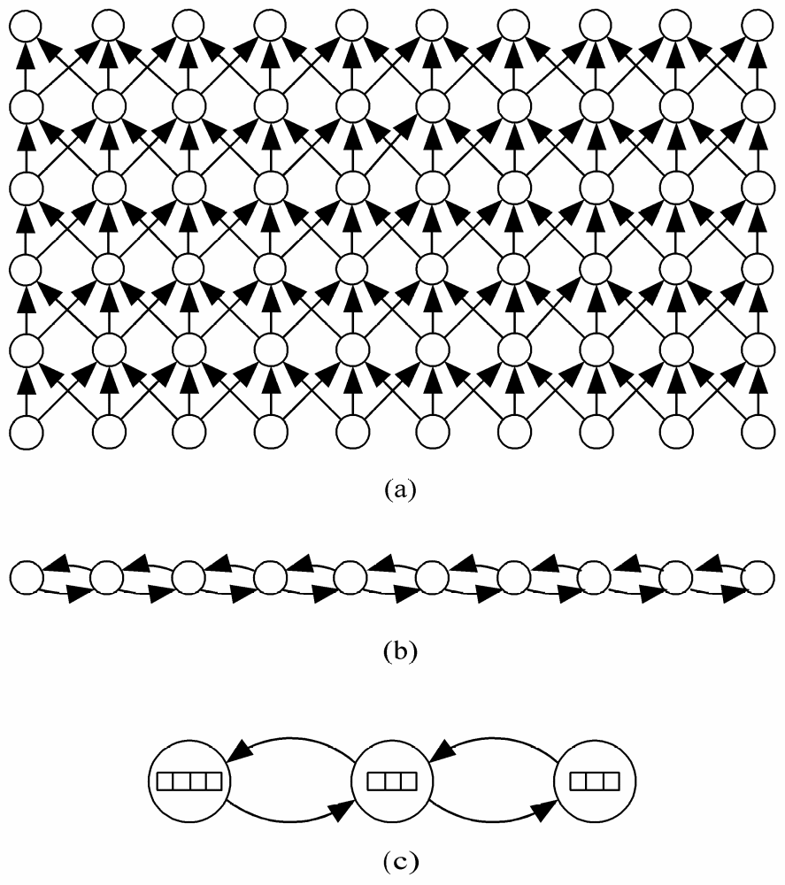

3. Agglomeration and 4. Mapping
Case 1. Boundary Value Problem
Agglomeration
Element i for all time steps.
Over all time steps.

Slide 30
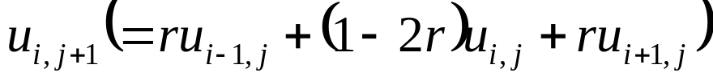

Sequential Execution Time
Case 1. Boundary Value Problem
The rod has been divided into n pieces of size h.
  χ – time to update element
  n – number of elements
  m – number of iterations
Sequential execution time:

Slide 31
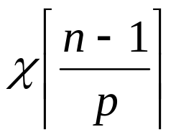
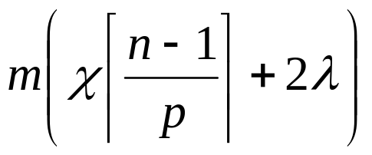
Parallel Execution Time
Case 1. Boundary Value Problem
If each processor is responsible for an equal-sized portion of the rod’s elements.
  p – number of processors
  λ – message latency
The computation time for each iteration:
Necessary communication time: 2λ
Parallel execution time:

Slide 32
Finding the Maximum Error
Case 2. Finding the Maximum
The error between the computed solution x and correction solution is |(x – c) / c|.
Enhance previous parallel algorithm to find the maximum error.
Computed | 0.15 | 0.16 | 0.16 | 0.19
Correct | 0.15 | 0.16 | 0.17 | 0.18
Error (%) | 0.00% | 0.00% | 6.25% | 5.26%
6.25%

Slide 33
Reduction
Case 2. Finding the Maximum
Given
  a set of n values a₀, a₁, a₂, …, a_{n–1}
  an associative operator ⊕
Reduction is the process of computing
a₀ ⊕ a₁ ⊕ a₂ ⊕ … ⊕ a_{n–1}
  Examples: add, multiply, AND, OR, maximum, minimum
Reduction requires exactly n–1 operations,
it has Θ(n) time complexity on a sequential computer.
  How to perform a reduction on parallel computer quickly?

Slide 34
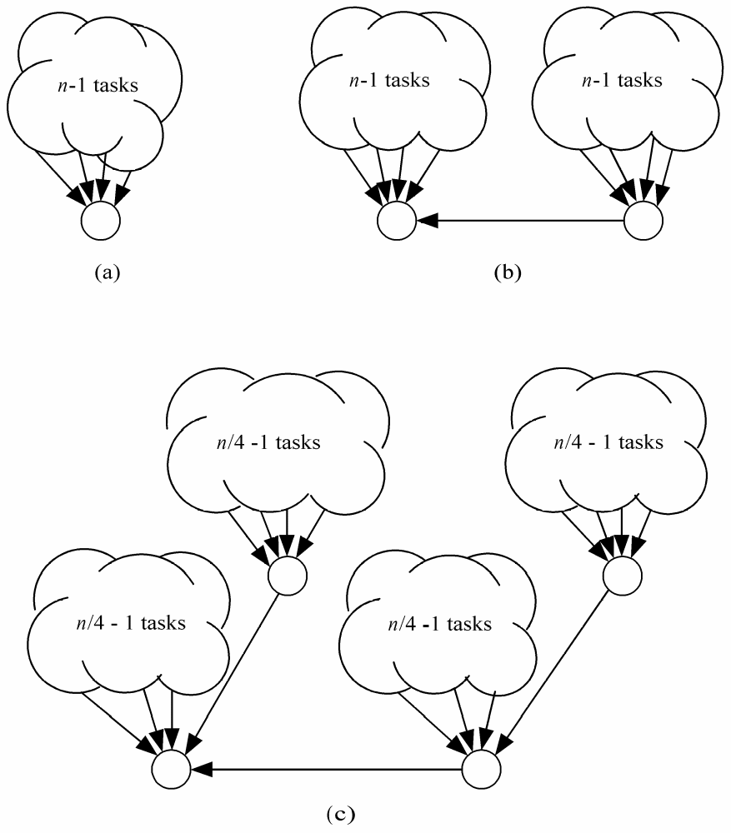
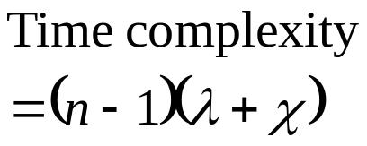
Parallel Reduction Evolution (1)
Case 2. Finding the Maximum
Partitioning
  Divide it into n pieces, one task per piece.
Communication
  χ – time to perform an addition
  λ – message latency
Only one task receives
all other n–1 results.

Slide 35

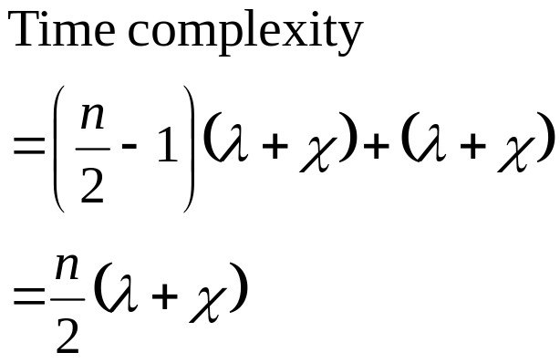
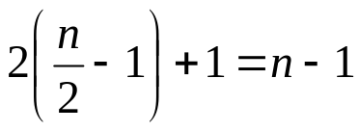
Parallel Reduction Evolution (2)
Case 2. Finding the Maximum
Two tasks work together.

Slide 36
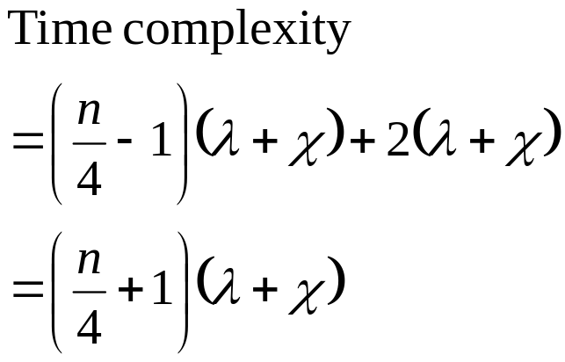
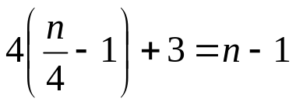
Parallel Reduction Evolution (3)
Case 2. Finding the Maximum
Four task cooperate.

Slide 37
Continue … Binomial Trees
Case 2. Finding the Maximum
Subgraph of Hypercube
n = 2^{k}
k = log n
Binomial trees with 1, 2, 4, and 8 nodes.

Slide 38
Finding Global Sum in logarithmic time
Case 2. Finding the Maximum
4
2
0
7
-3
5
-6
-3
8
1
2
3
-4
4
6
-1

Slide 39
Finding Global Sum
Case 2. Finding the Maximum
1
7
-6
4
4
5
8
2

Slide 40
Finding Global Sum
Case 2. Finding the Maximum
8
-2
9
10

Slide 41
Finding Global Sum
Case 2. Finding the Maximum
17
8

Slide 42
Finding Global Sum
Case 2. Finding the Maximum
Binomial Tree
25

Slide 43
Agglomeration and Mapping
Case 2. Finding the Maximum
n tasks mapped to
p processors
16 tasks are mapped to 4 processors.

Slide 44
Agglomerate Primitive Tasks
Case 2. Finding the Maximum
sum
sum
n/p primitive tasks
with 1 value
⇓
1 primitive tasks
with n/p values
sum
sum
4 tasks on each processor are agglomerated
into a single task

Slide 45
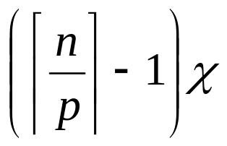
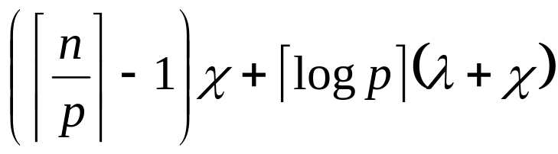
Analysis
  χ – time to perform the binary operation
  λ – message latency
All tasks performance concurrently:
A reduction of p values distributed among p tasks can be preformed in ⎡log p⎤ communication steps.
Each reduction stop requires time: λ + χ
Overall execution time:

Slide 46
The n-Body Problem
Case 3. The n-Body Problem
Newtonian n-body simulation.
Straightforward sequential algorithms
Time complexity: Θ(n²) per iteration.

Slide 47
The n-Body Problem
Case 3. The n-Body Problem
Straightforward sequential algorithms
Time complexity: Θ(n²) per iteration.

Slide 48
Partitioning
Case 3. The n-Body Problem
Domain partitioning
Assume one task per particle
Task
  particle’s position
  velocity vector
Iteration
  Get positions of all other particles
  Compute new position, velocity

Slide 49
Gather
Case 3. The n-Body Problem

Slide 50
All-gather
Case 3. The n-Body Problem

Slide 51
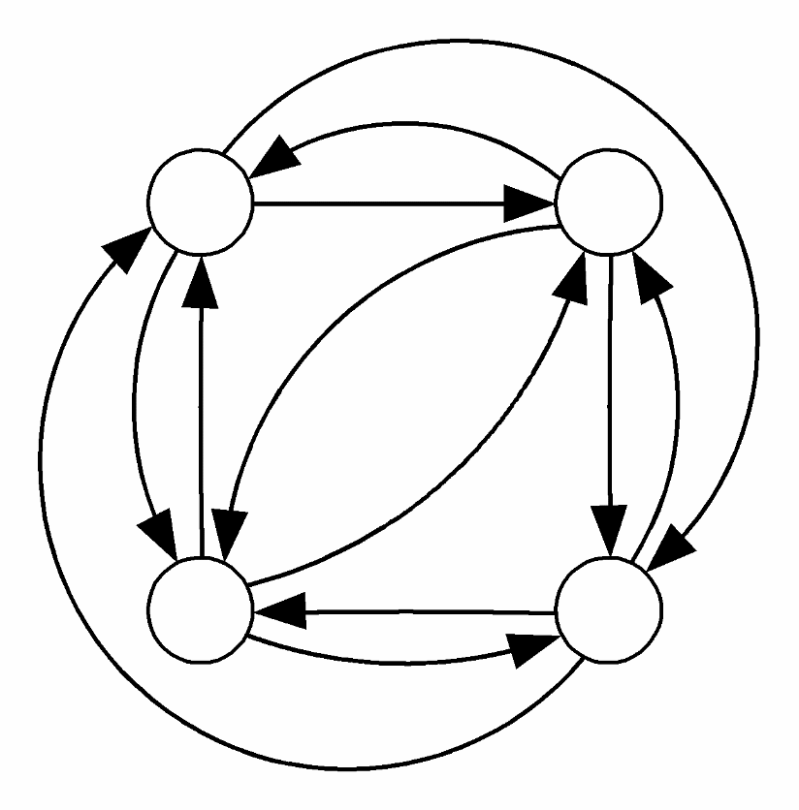
Complete Graph for All-gather
Case 3. The n-Body Problem
Set up a channel between every pair of tasks.

Slide 52
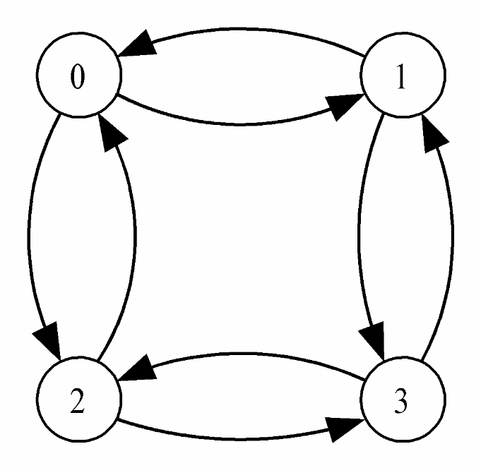
Hypercube for All-gather
Case 3. The n-Body Problem
Each task have only log p outgoing channels
and log p incoming channels

Slide 53
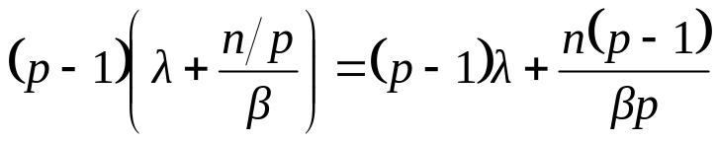
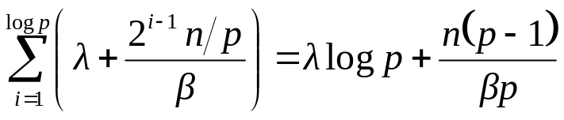
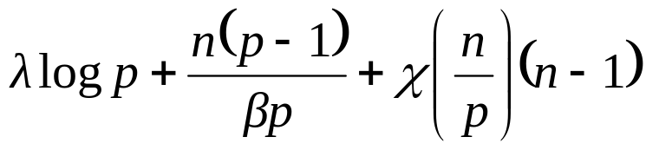
Analysis
Case 3. The n-Body Problem
  β – bandwidth of each channel
Communication time
  Complete graph
  Hypercube
Overall time complexity
Error in textbook

Slide 54
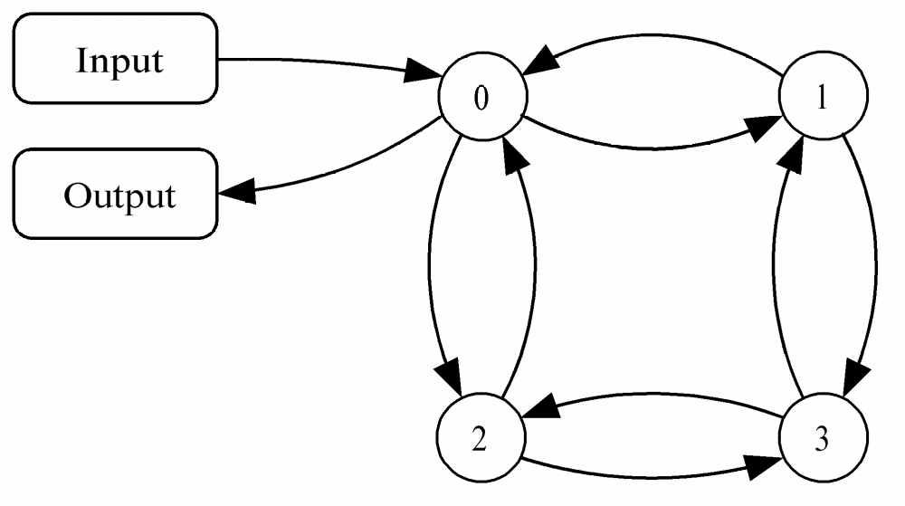
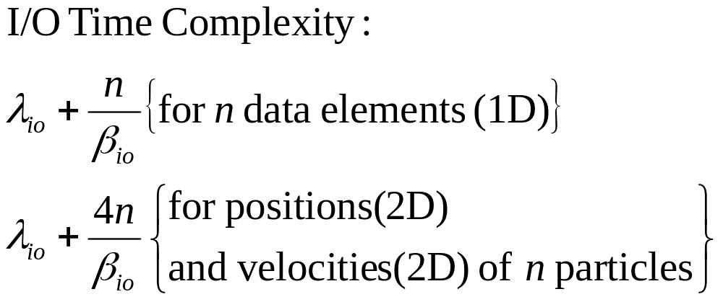
Adding Data Input
Case 4. Adding Data Input
Augment the task/channel graph for the n-body problem
Task 0 is responsible for I/O.

Slide 55
Scatter
Case 4. Adding Data Input

Slide 56
Scatter in log p Steps
Case 4. Adding Data Input
12 34
56 78
12 34
56 78
12 34
56 78
56 78
56 78
34
78

Slide 57
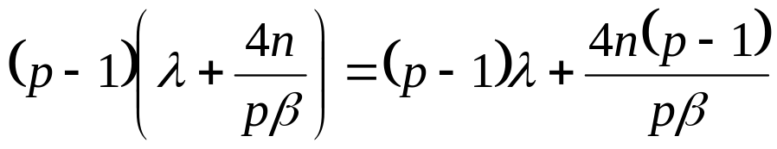
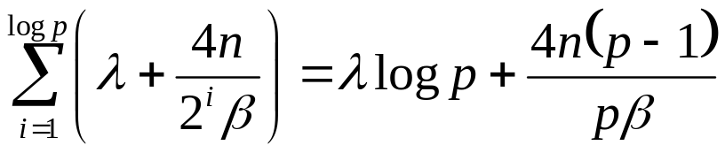
Communication
Time for scatter the particles (sequential)
  Send p–1 message, each of length 4n/p
Time for scatter the particles (in log p steps)
The “log p steps” algorithm is better.
Error in textbook

Slide 58
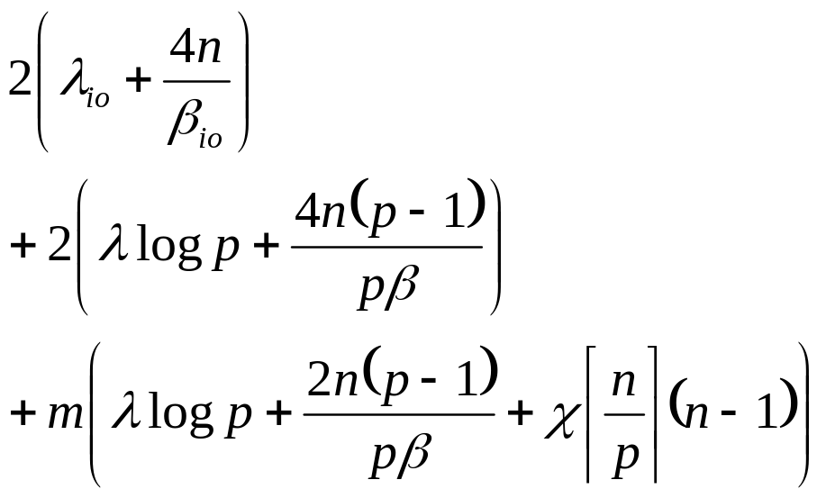
Analysis
Overall execution time for m iterations:
 | Input and Output
 | Log p steps scattering
 | All-gather and computation

Slide 59
Summary: Task/channel Model
Parallel computation
  Set of tasks
  Interactions through channels
Good designs
  Maximize local computations
  Minimize communications
  Scale up

Slide 60
Summary: Design Steps
Partition computation
Agglomerate tasks
Map tasks to processors
Goals
  Maximize processor utilization
  Minimize inter-processor communication

Slide 61
Summary: Fundamental Algorithms
Reduction
Gather and scatter
All-gather

Slide 62
Exercise
3.11
3.13
3.18, 3.19

Slide 63
Discussion
Real world
  Processor
    Single Core
    Hyper-threading, multi-threading
      http://www.intel.com/personal/desktop/dualcore/demo/popup/demo.htm
    Dual Core
  Programming
    Multi-thread (share memory space)
    Multi-process (no share memory space)
    → extend to MPI process.

Slide 64
Parallelization Policy
Primitive Task
Task
Agglomerated Task
1-to-1 mapping?
Inter-Process Communication
Broadcast/reduction
Gather/scatter
All-gather
Process
1-to-1 mapping?
Processor

